Slide 1
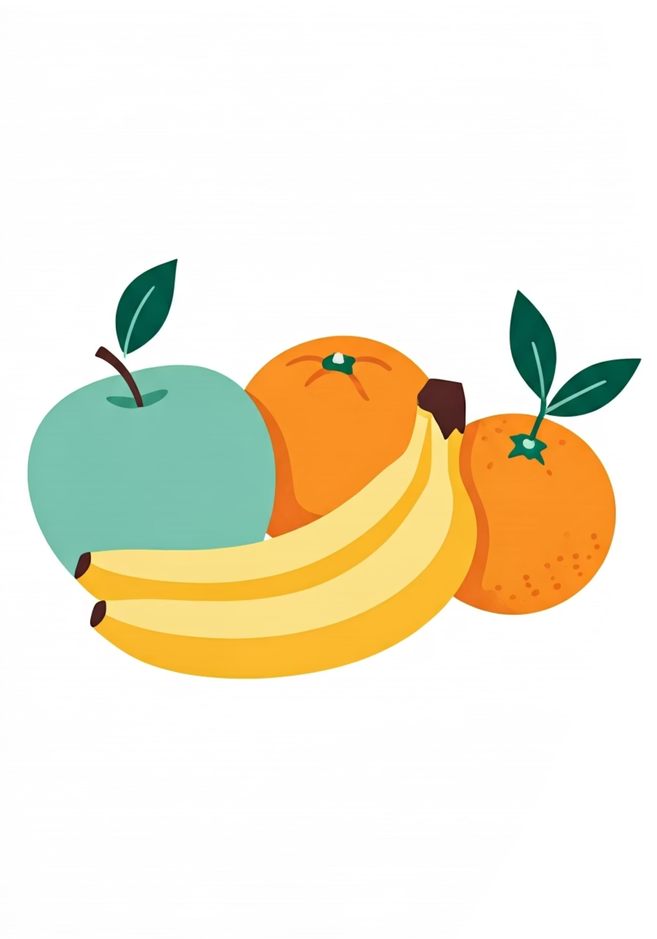

Fruit Classification using Deep Learning
Apple, Banana & Orange Recognition
This project explores the application of deep learning techniques to accurately classify fruit images. Using a curated dataset of 240 training and 60 testing images, we developed and compared multiple neural network architectures to achieve high-accuracy fruit recognition capable of real-world deployment.
Arnav Gupta
Spandan Basu Chaudhuri

Slide 2

Problem Statement
The Challenge
Identifying and classifying objects in images represents a fundamental challenge in computer vision. Fruits present unique difficulties due to overlapping visual characteristics—similar shapes, colors, and textures can confuse classification systems.
Our goal: develop a robust model that can accurately distinguish between apples, bananas, and oranges with high confidence, suitable for real-time applications.
Visual Similarity
Fruits share overlapping colors and rounded shapes, making precise classification challenging without sophisticated feature extraction.
High Accuracy Required
Real-world applications demand reliable performance across varying lighting conditions, angles, and fruit varieties.
Real-Time Performance
The model must process images quickly enough for practical deployment in sorting systems and mobile applications.

Slide 3



Dataset Overview
Our foundation: the Fruit Images for Object Detection dataset, carefully structured with balanced class representation and detailed annotations for supervised learning.
240
60
3
Training Images
Test Images
Fruit Classes
Comprehensive set for model learning
Validation and performance evaluation
Apple, Banana, Orange
Apple
Banana
Orange
Red and green varieties with characteristic round shape and stem depression
Distinctive elongated curved shape with yellow coloring and natural segmentation
Spherical citrus with textured orange peel and characteristic dimpled surface
Each image is accompanied by XML annotation files that precisely define bounding boxes and class labels, enabling accurate supervised training.

Slide 4
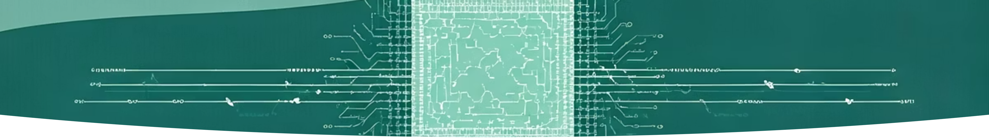
Data Preprocessing Pipeline
Transforming raw images into model-ready inputs requires systematic preprocessing to ensure consistency, efficiency, and optimal learning performance.
Image Resizing
Normalization
All images standardized to 224×224 pixels to match neural network input requirements and reduce computational complexity.
Pixel values scaled to 0–1 range, improving gradient flow and accelerating convergence during training.
Label Extraction
TensorFlow Pipeline
Class labels parsed from XML annotation files and encoded into categorical format for classification.
Dataset converted to tf.data format, enabling batching, prefetching, and efficient GPU utilization.

Slide 5

Model 1: Custom CNN Architecture
Baseline Convolutional Network
We began with a custom-designed Convolutional Neural Network (CNN) built from scratch—a straightforward architecture ideal for establishing baseline performance.
Architecture Components
Convolutional Layers: Feature extraction with increasing filter depth
MaxPooling: Spatial dimension reduction and translation invariance
Flatten Layer: Converting 2D features to 1D vector
Dense Layers: Fully connected classification with Softmax activation
Advantages
Limitations
Lightweight and fast to train
Limited feature learning capacity
Low computational requirements
Lower accuracy on small datasets
Easy to understand and modify
Requires more training data for optimal performance

Slide 6

Model 2: Transfer Learning with MobileNetV2
Leveraging knowledge from ImageNet—a massive dataset of 1.4 million images across 1,000 categories—we employed MobileNetV2, a state-of-the-art architecture optimized for mobile and embedded vision applications.
01
02
Load Pre-trained MobileNetV2
Remove Classification Head
Import model trained on ImageNet, inheriting powerful feature extraction capabilities developed across millions of images.
Strip away the original 1,000-class output layer, preserving only the convolutional base for feature extraction.
03
04
Add Custom Classification Layers
Freeze Base Layers
Attach Global Average Pooling followed by a Dense layer with 3 outputs (Apple, Banana, Orange) and Softmax activation.
Initially freeze pre-trained weights to preserve learned features while training only the new classification head.
Why Transfer Learning? With limited training data (240 images), transfer learning allows us to leverage features learned from millions of images, dramatically improving performance and reducing training time.

Slide 7


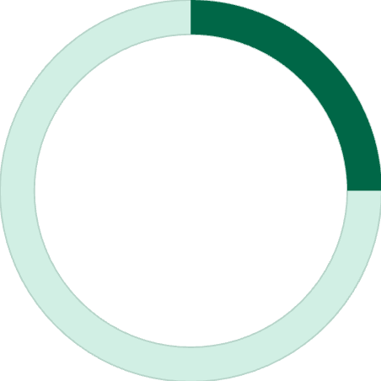
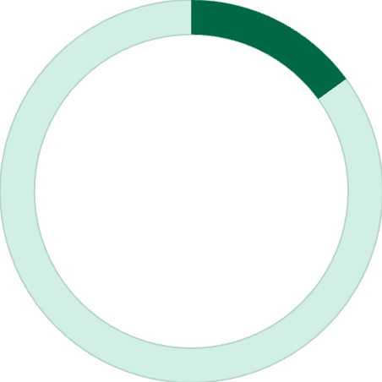
Fine-Tuning Strategy
Unlocking Deeper Learning
After initial training with frozen base layers, we progressively unfroze the top layers of MobileNetV2, allowing the model to adapt pre-learned features specifically to our fruit classification task.
Fine-Tuning Approach
Selective Unfreezing: Enabled training for deeper MobileNet layers while keeping early layers frozen
Lower Learning Rate: Used reduced learning rate to prevent catastrophic forgetting
Dropout Regularization: Added dropout layers to prevent overfitting on small dataset
95%
25%
15
Peak Accuracy
Accuracy Gain
Unfrozen Layers
Achieved after fine-tuning
Improvement over baseline CNN
Top layers adapted to fruits
Result: Fine-tuning delivered significant accuracy improvements, demonstrating the power of adaptive transfer learning for domain-specific tasks.

Slide 8
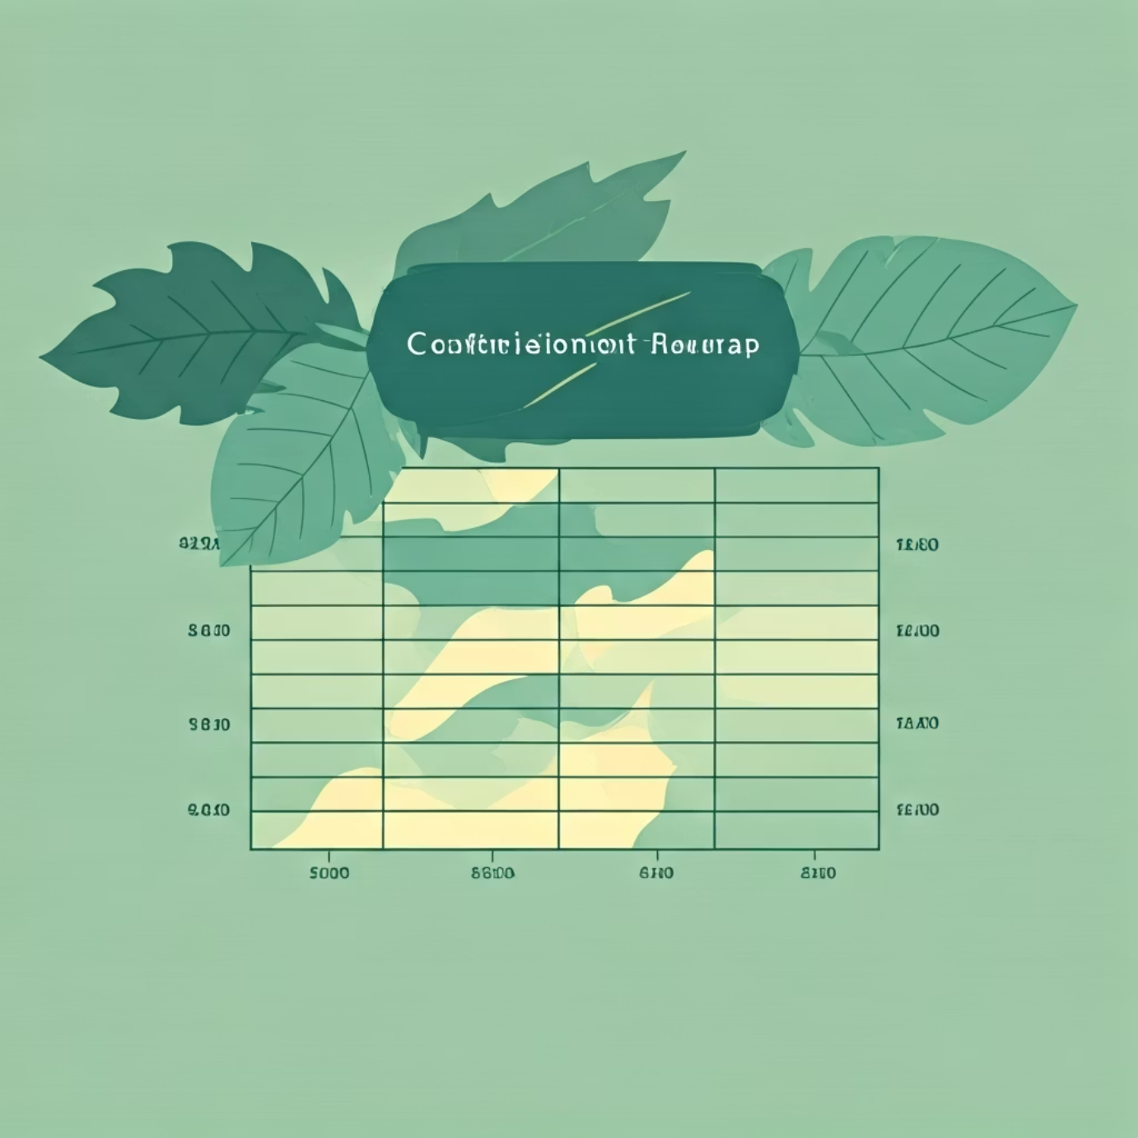
Results & Model Comparison
Comprehensive evaluation across three architectures reveals the dramatic impact of transfer learning and fine-tuning on classification performance.
Model Architecture
Test Accuracy
Key Characteristics
Simple CNN
70–78%
Struggles with similar colors and textures
Transfer Learning (MobileNetV2)
90–94%
Significantly better feature recognition
Fine-Tuned Transfer Model
95%+
Best performing with adapted features
Performance Insights
The confusion matrix reveals exceptional performance across all three fruit classes, with minimal misclassification. The fine-tuned model demonstrates particularly strong discrimination between visually similar fruits.
High precision for all classes (>93%)
Balanced recall across apples, bananas, and oranges
Strong generalization to unseen test examples

Slide 9
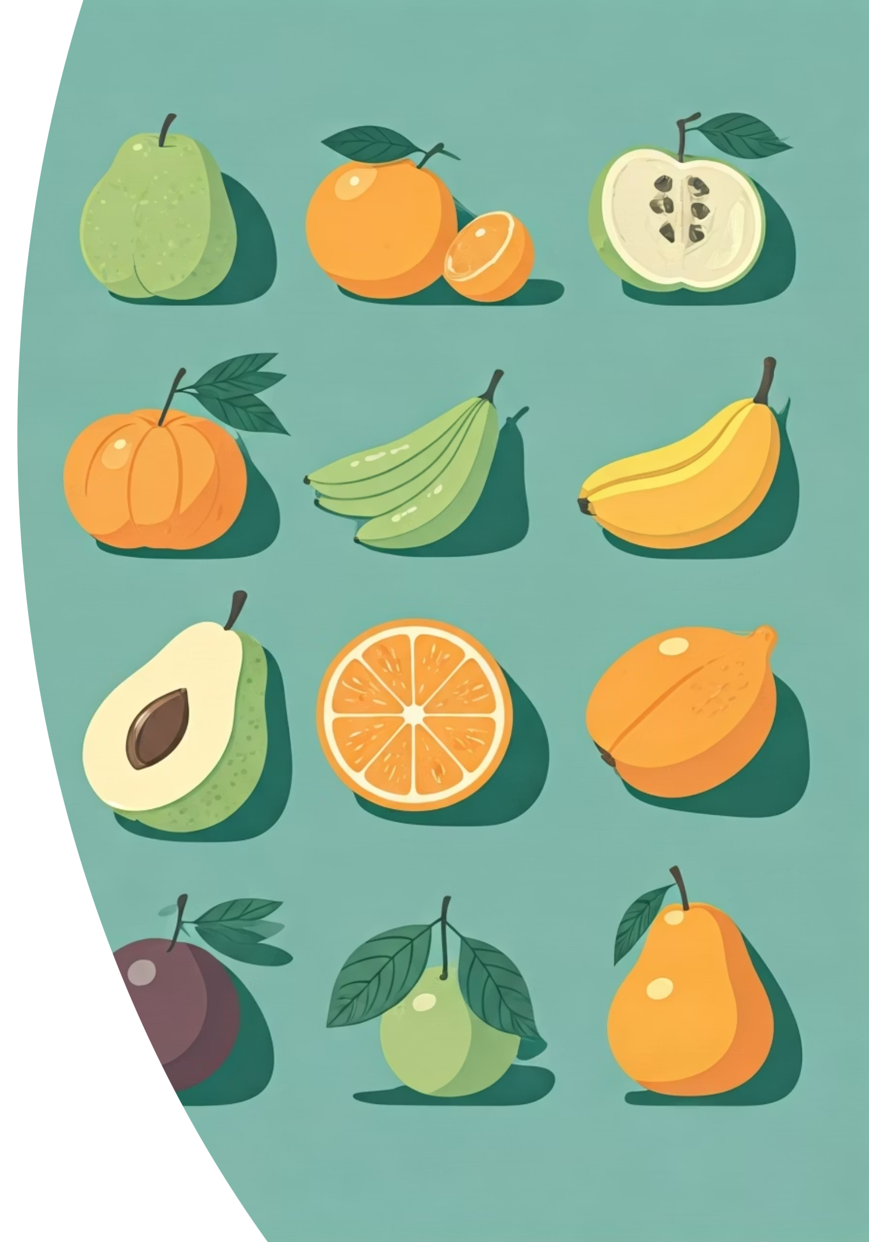





Model Testing & Validation
Rigorous evaluation using multiple testing methodologies confirms the model's robustness and real-world applicability beyond the training distribution.
Random Test Predictions
Model evaluated on randomly sampled images from the test set, demonstrating consistent high-confidence predictions across diverse examples.
Multi-Image Grid Visualization
Batch predictions displayed in grid format reveal model behavior across multiple samples simultaneously, highlighting consistency.
Classification Reports
Detailed metrics including precision, recall, and F1-scores calculated per class, providing comprehensive performance insights.
Real-World Images
Model tested on images captured outside the original dataset, successfully generalizing to new lighting conditions and angles.
Key Finding: The model demonstrates excellent generalization capability, maintaining high accuracy even on out-of-distribution images with varying backgrounds and lighting conditions.

Slide 10
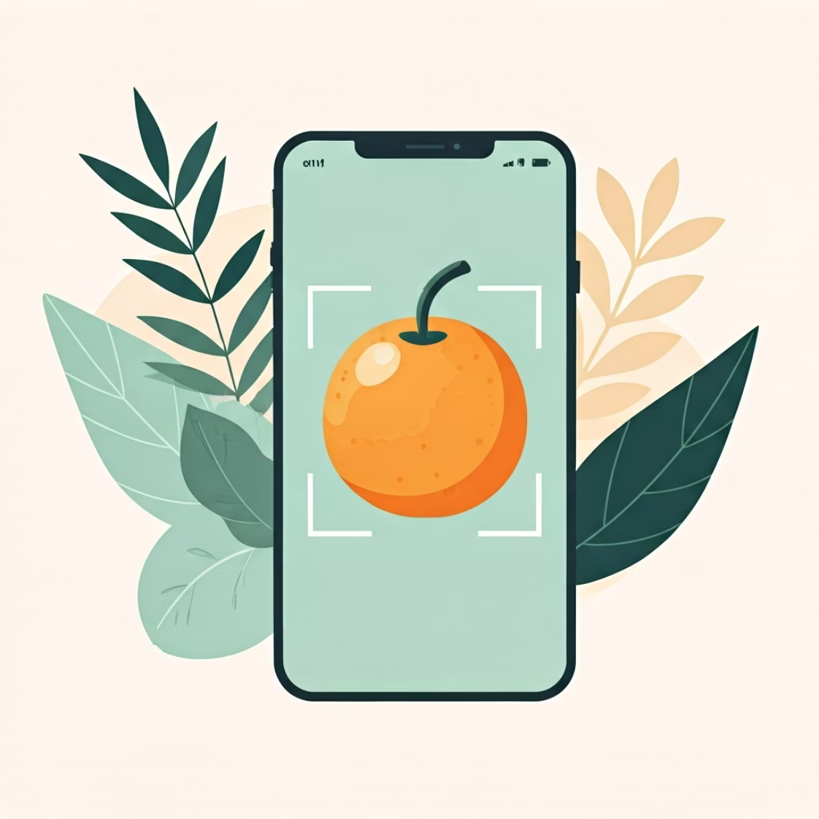



Conclusion & Future Directions
Project Success
Transfer learning with MobileNetV2 proved highly effective, with fine-tuning pushing accuracy beyond 95%—far exceeding our baseline CNN performance.
The model is production-ready and suitable for deployment in practical applications requiring fast, accurate fruit classification.
Mobile Applications
Automated Sorting
Retail Automation
Consumer apps for nutritional tracking and smart shopping
Industrial fruit sorting and quality control systems
Self-checkout systems and inventory management
Future Enhancements
YOLO Object Detection
Real-Time System
Extend to detecting multiple fruits simultaneously in a single image with bounding boxes
Deploy as live camera feed classifier for instant fruit recognition in retail environments

